Slide 1
AI CHATBOT Based on Natural Language Processing[NLP]
Project presented by:
Ramgopal J
Sambhu Nampoothiri G
Krishna Dev R

Slide 2
Introduction:
An NLP based chatbot is a computer program or artificial intelligence that communicates with a customer via textual or sound methods. Such programs are often designed to support clients on websites or via phone. The chatbots are generally used in messaging applications like Slack, Facebook Messenger, or Telegram.
Chatbots can be developed and used as an interactive AI that can act as your personal companion.

Slide 3
Motivation:
AI based chatbots can used to ease the workload of customer care executives and can deal with any number of customers at the same time with very high efficiency.
This can also reduce the wrong informations and errors caused by human interference.

Slide 4
Methodology:
The function of our chatbot was to take the user input, identify the intent of the user question and match it to one of the tags in the dataset. Then one random reply is send to the user from the responses mentioned inside the tag.
So firstly we make our dataset. Our dataset is json file which has various tags like Greeting, Goodbye, Help etc. Each tag has two sub classes, one is "patterns" class and another is the response class.
The patterns class contains a list of questions similar to which the user may ask with the intent meaning same as the tag.
The response tag contains the replies or answers the chatbot gives when the user asks any questions that matches the tag.

Slide 5
Training the Chatbot:
We firstly load our dataset file and extract the 'patterns' class for training the model.
The variable “training_sentences” holds all the training data (which are the sample messages in each intent category) and the “training_labels” variable holds all the target labels correspond to each training data.
Then we use “LabelEncoder()” function provided by scikit-learn to convert the target labels into a model understandable form.

Slide 6
Next, we vectorize our text data corpus by using the “Tokenizer” class and it allows us to limit our vocabulary size up to some defined number. When we use this class for the text pre-processing task, by default all punctuations will be removed, turning the texts into space-separated sequences of words, and these sequences are then split into lists of tokens. They will then be indexed or vectorized.
“oov_token” which is a value for “out of token” is used to deal with out of vocabulary words(tokens) at inference time.
The “pad_sequences” method is used to make all the training text sequences into the same size.

Slide 7
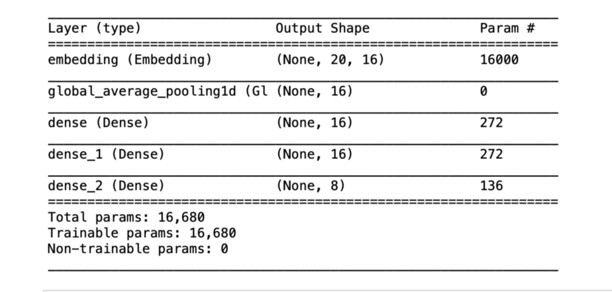
Model:
We used the “Sequential” model class of Keras.
Our model architecture looks like this,

Slide 8
Inference:
We have implemented a chat function to engage with a real user.
When a new user message is received, the chatbot will calculate the similarity between the new text sequence and training data.
Considering the confidence scores got for each category, it categorizes the user message to an intent with the highest confidence score.

Slide 9
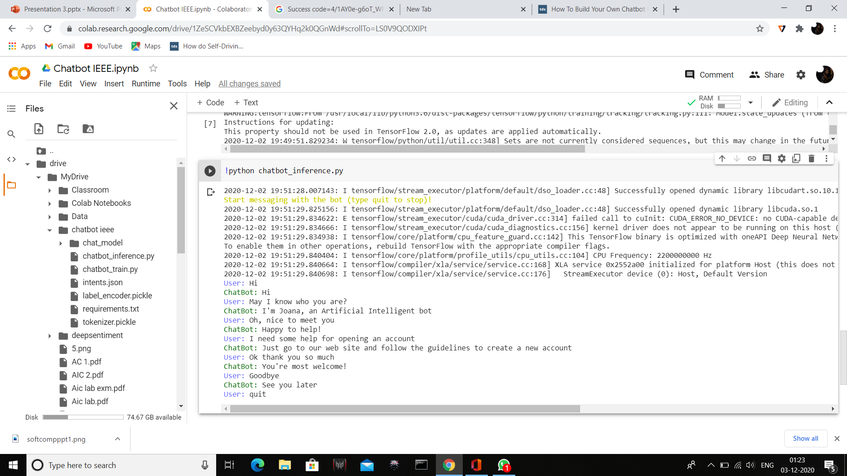
Result:

Slide 10
The above model was trained on Google Colab GPU for 5000 epochs.
At the end of 5000 epochs,
Loss: 9.0007e-05
Accuracy: 1.0000

Slide 11
Conclusion:
We have made a chatbot that finds the intend of the user messages and gives them reply as per their questions.
The above chatbot can provide an excellent solution to modern day customer care problems and can reduce human made errors when replying to those problems.
As for further development, we are also trying to add Sentiment Analysis to user inputs so that we can learn the user emotions and select our replies accordingly.

Slide 12
THANK YOU

